Slide 1





Additional knowledge on Ionic
Fauzi Sholichin
fauzisholih@gmail.com
+6289673732142
https://www.linkedin.com/in/fauzisho/

Slide 2
Introduction
Mobile Dev Landscape
Difference between platform
Ionicframework Architecture Overview
Summary

Slide 3
Mobile Dev Landscape
Native Apps
IOS, Android
HTML5 Apps
Standard web technologies – HTML, CSS(SASS), Javascript(Typescript)
Hybrid Apps
Web app in a thin native container.

Slide 4
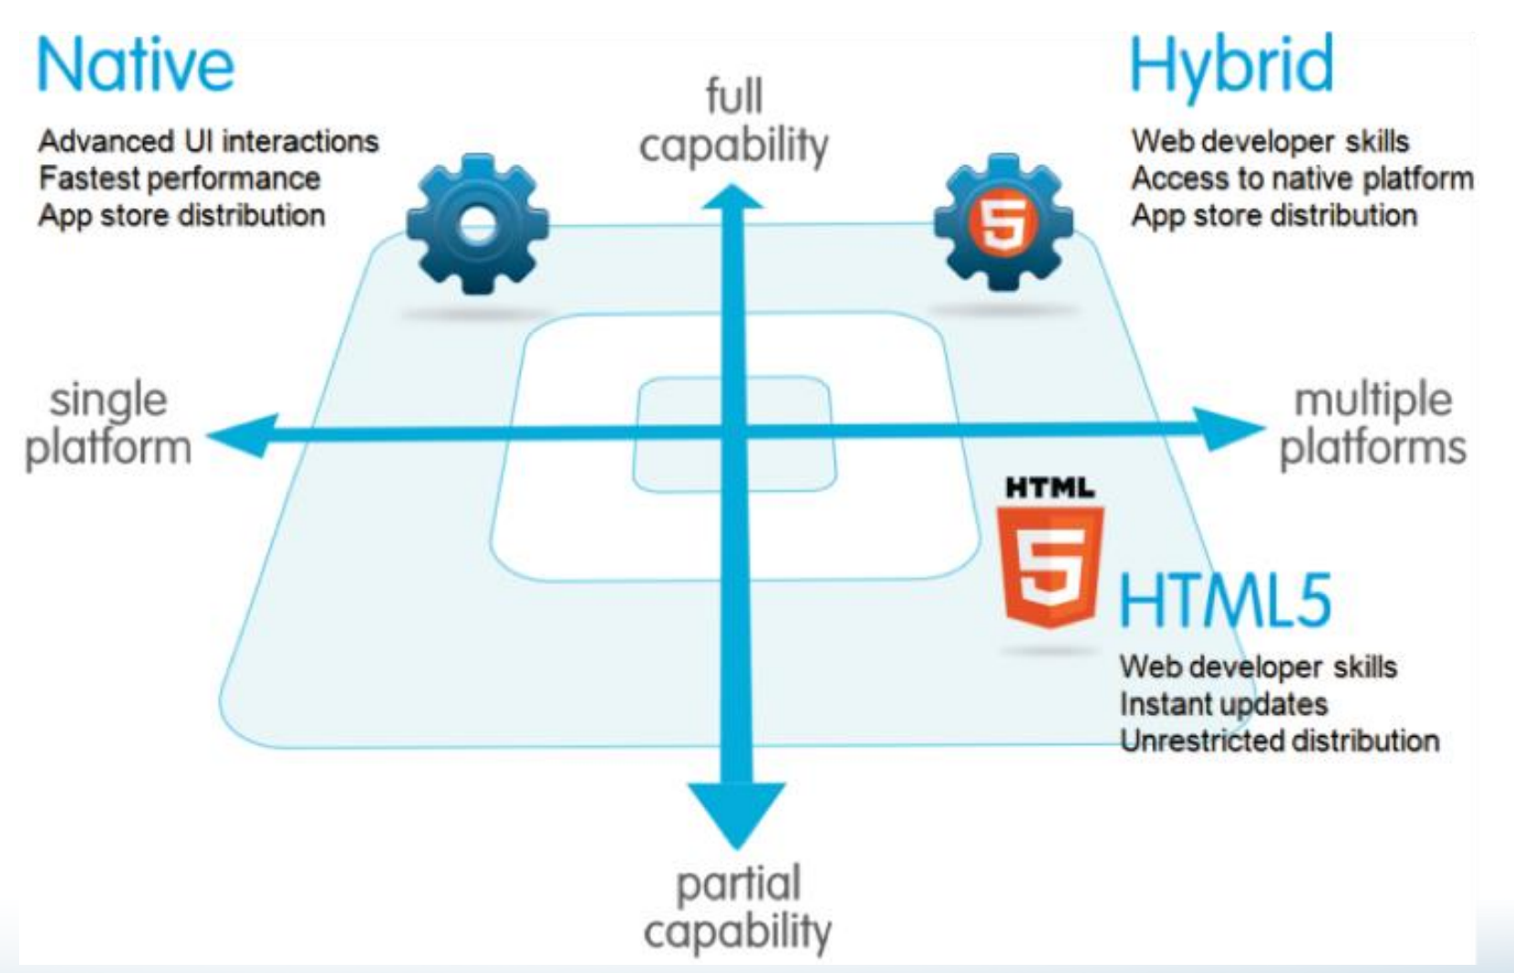
Mobile Dev Landscape

Slide 5
Difference between platform
Native | Web App | Hybrid
Camera, Notifications, Contacts, Calendars | Only restricted to mobile browser | Camera, Notifications, Contacts, Calendars
Objective C, Swift, Java, Kotlin | HTML5, CSS, JavaScript | HTML5, CSS, JavaScript
Swipe, Pinch and Spread | Swipe | Swipe, Pinch and Spread

Slide 6
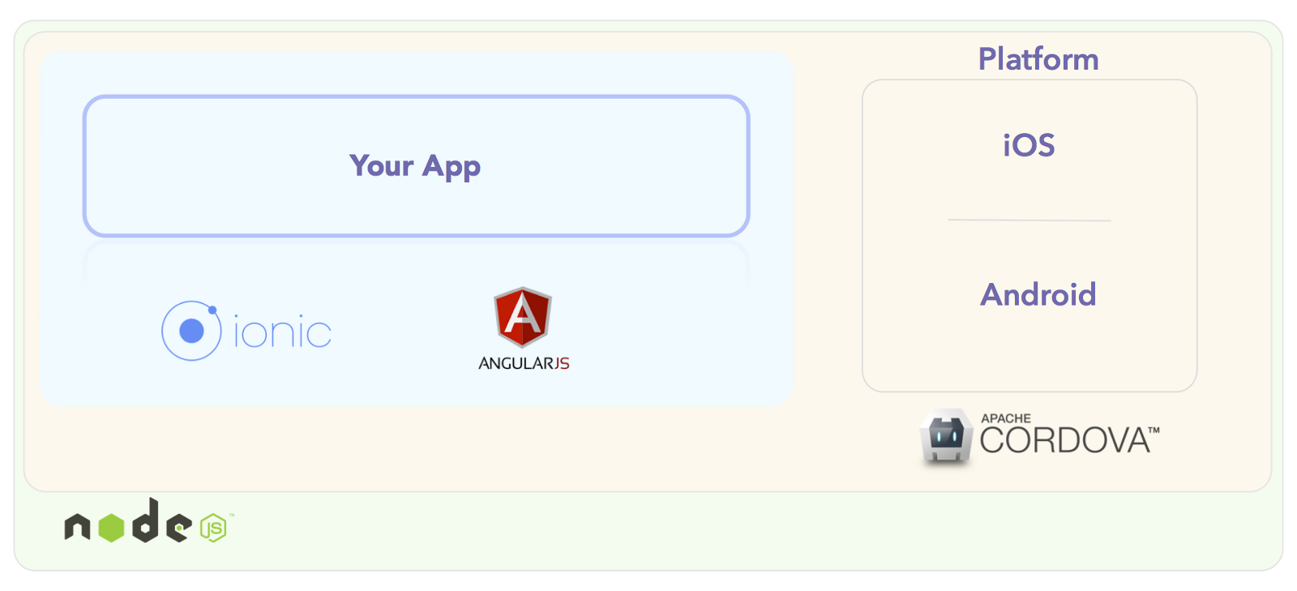
Ionicframework Architecture Overview

Slide 7

Angularjs
Popular open-source javascript framework to build dynamic web pages
Built and maintained by Google
Powerful data-binding
Follow MV* pattern

Slide 8

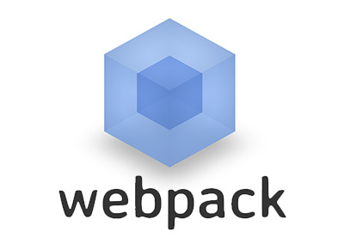
Ionic-app-script
As a task-runner
Just a wrapper function for npm-script
Common tasks
Minification
Uglify
Bundle source maps (webpack)
More details can reference
https://docs.npmjs.com/misc/scripts
https://webpack.js.org/guides/getting-started/

Slide 9

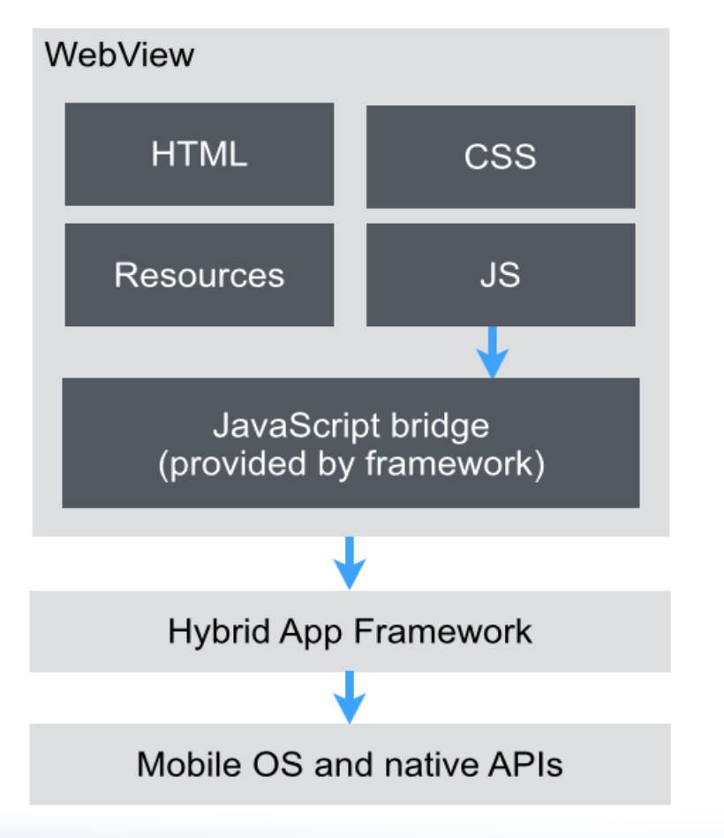
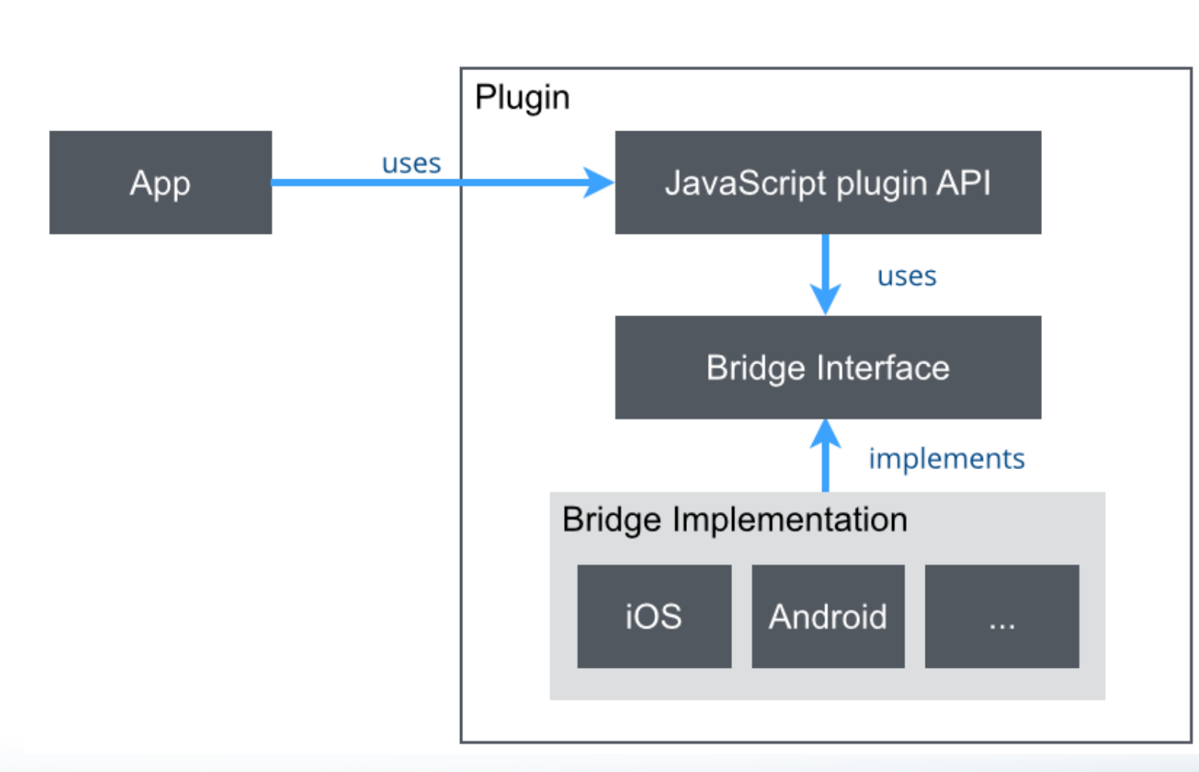
Cordova Architecture

Slide 10
Ionic structure -Summary
Angular JS – to structure the application
Cordova – Used to add native device support via plugins
Npm Script –Steaming build system
Build file is code
Minify js, concatenate files
Tasks are executed with maximum concurrency

